Slide 1

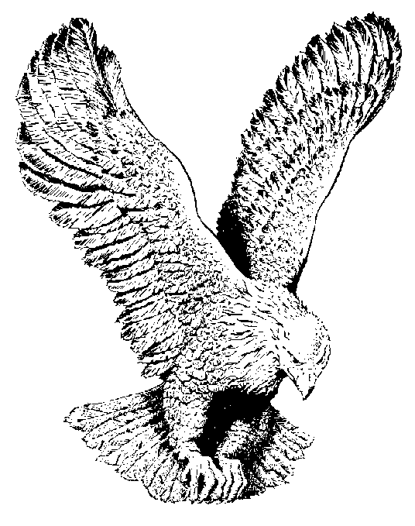
SOMEBODY TOUCHED ME
Glory, glory, glory, somebody touched me
Glory, glory, glory, somebody touched me
Glory, glory, glory, somebody touched me
Must have been the hand of the Lord.
-While I was praying somebody touched me (3 x)
-Standing in the healing line somebody
touched me (3x)

